Slide 1
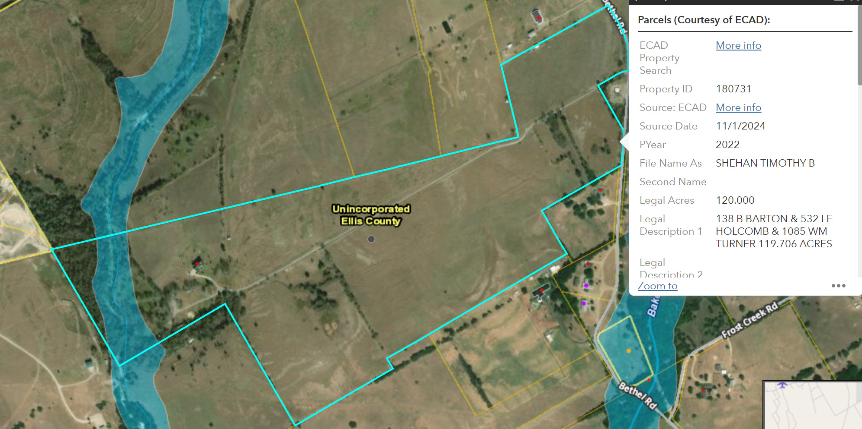

Slide 2
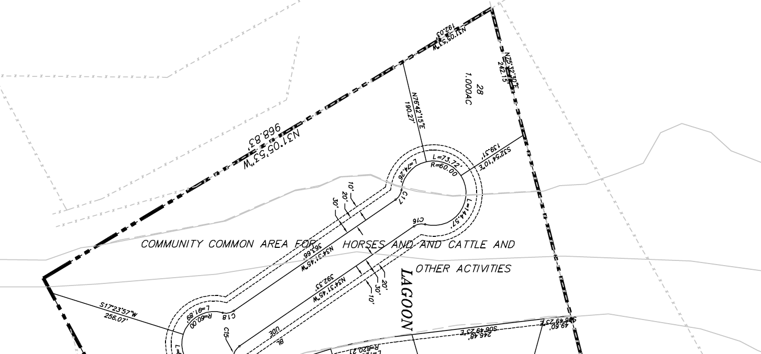
Remove the marked area

Slide 3
Add the following

Slide 4
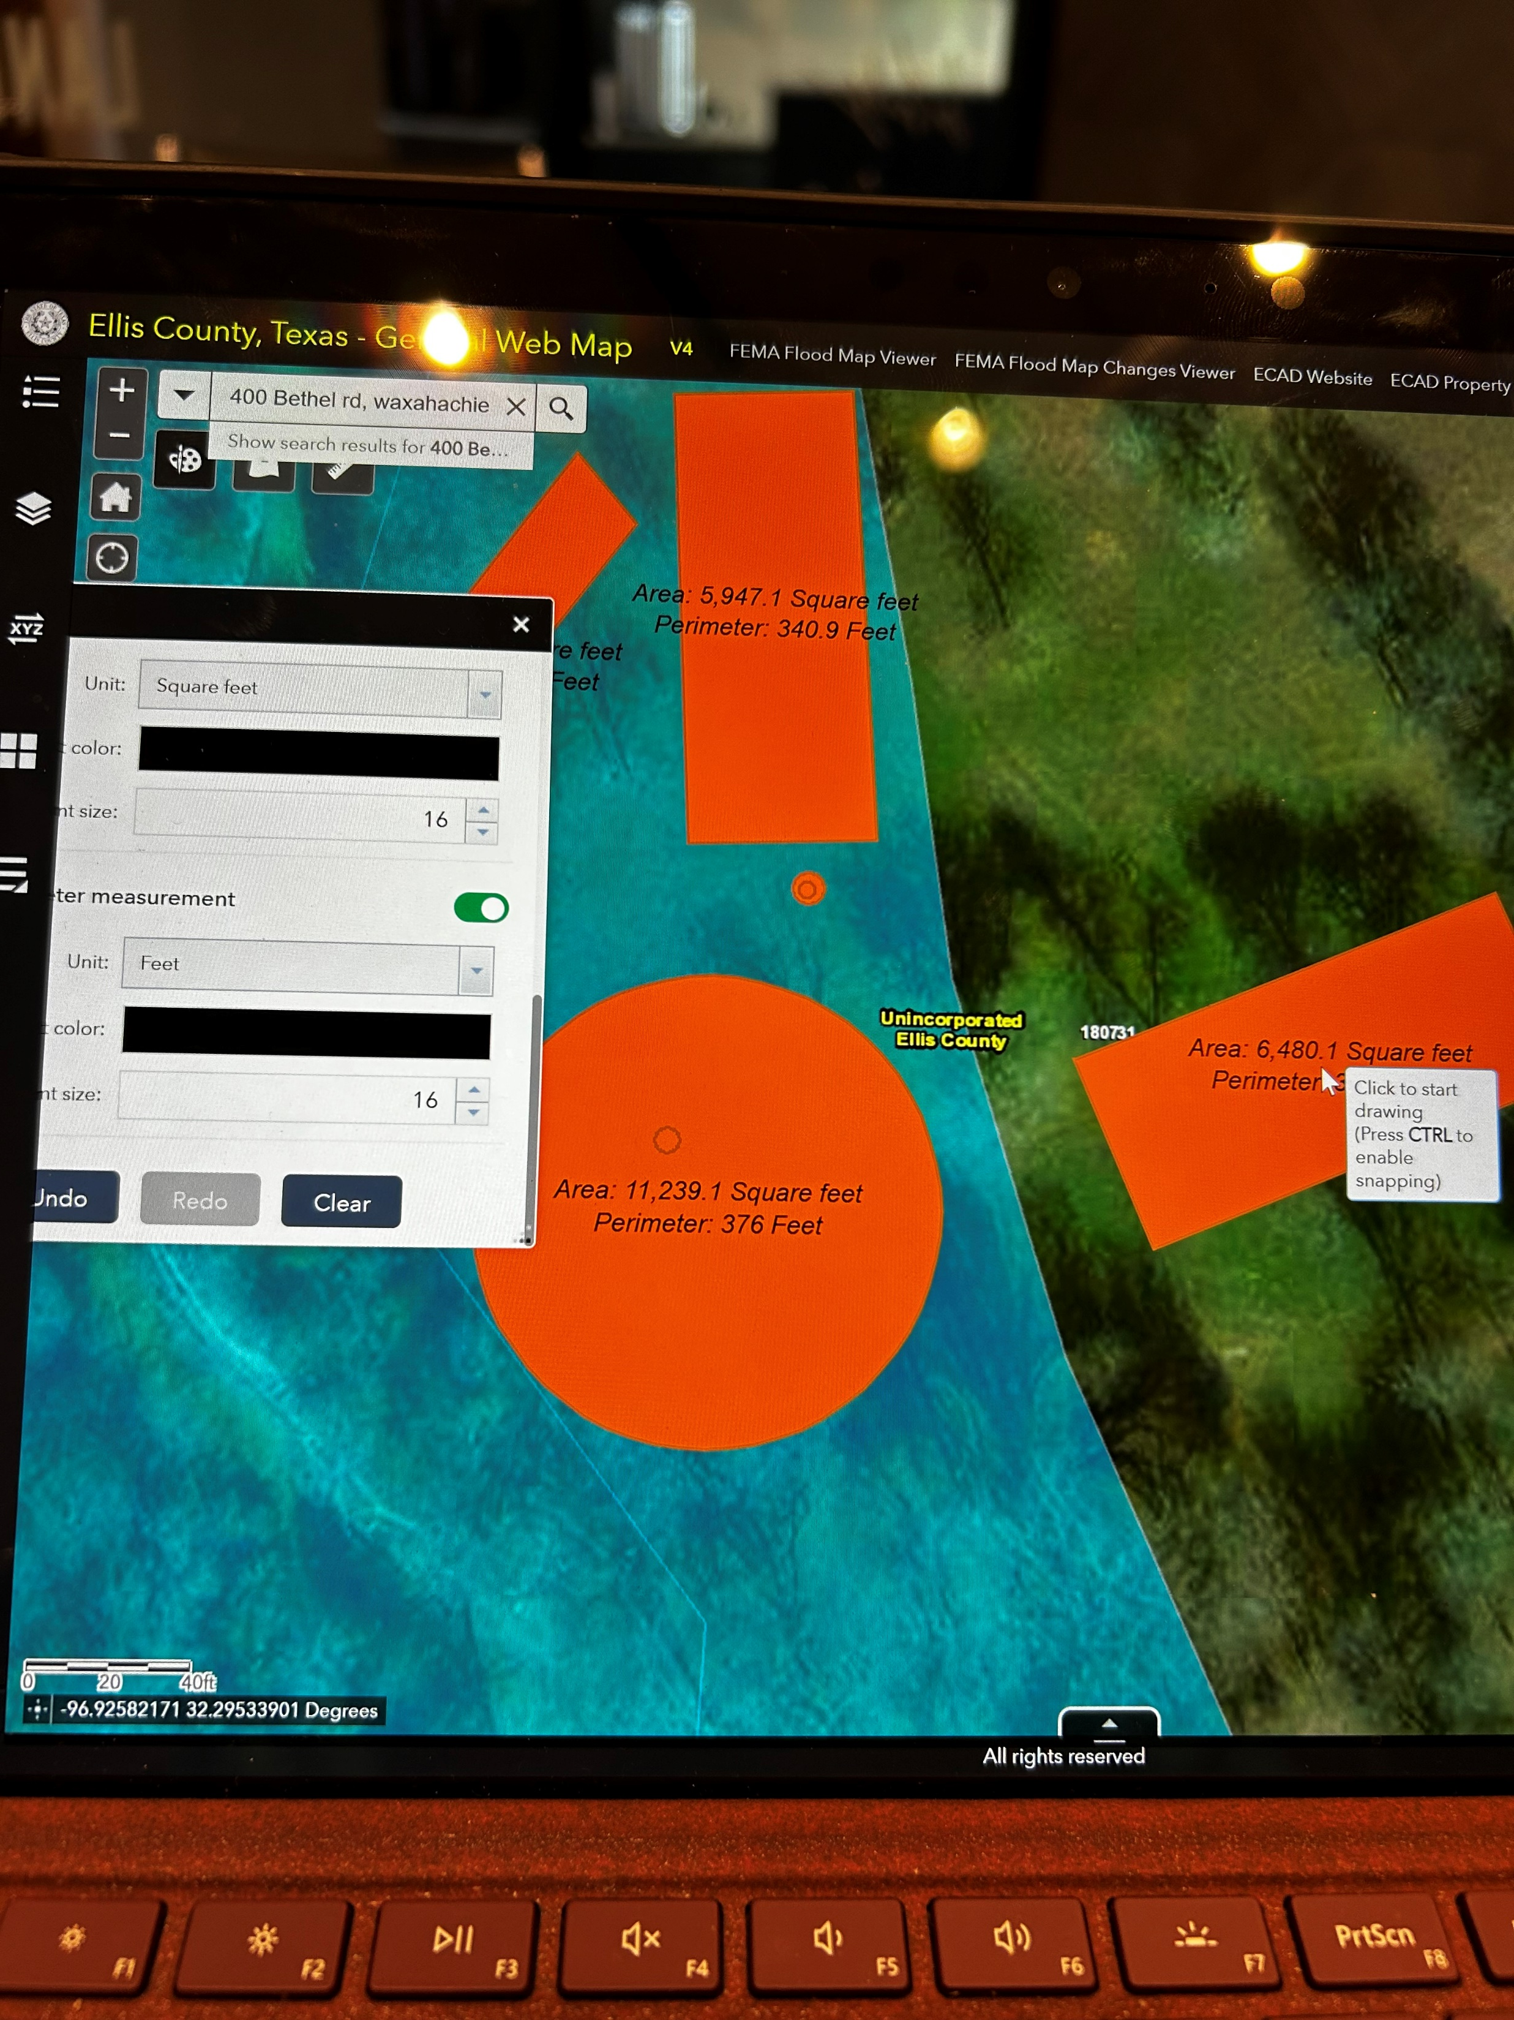

Center:
Pond/Lagoon
10,000 sq ft

Slide 5

Center:
Open Metal building 5,000 sq ft

Slide 6
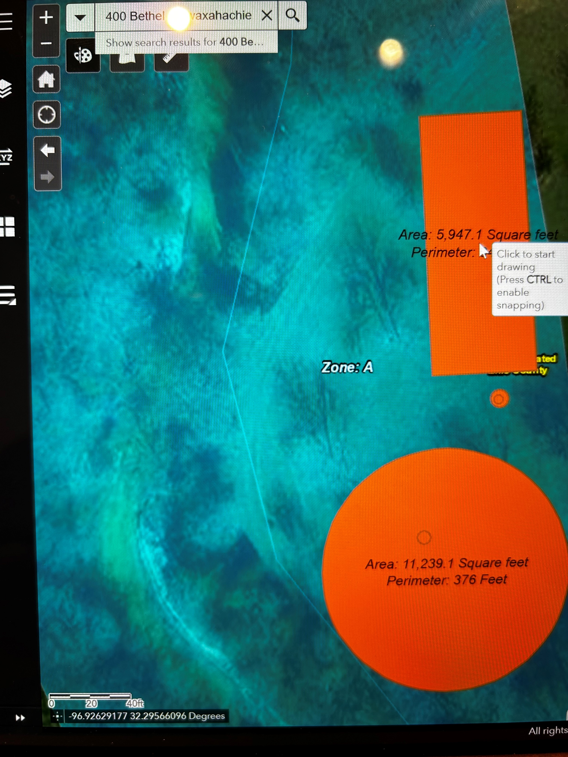
Center:
Multi Purpose Outdoor Sports Area
Tennis/Pickle ball/Volleyball
5,000 sq ft

Slide 7
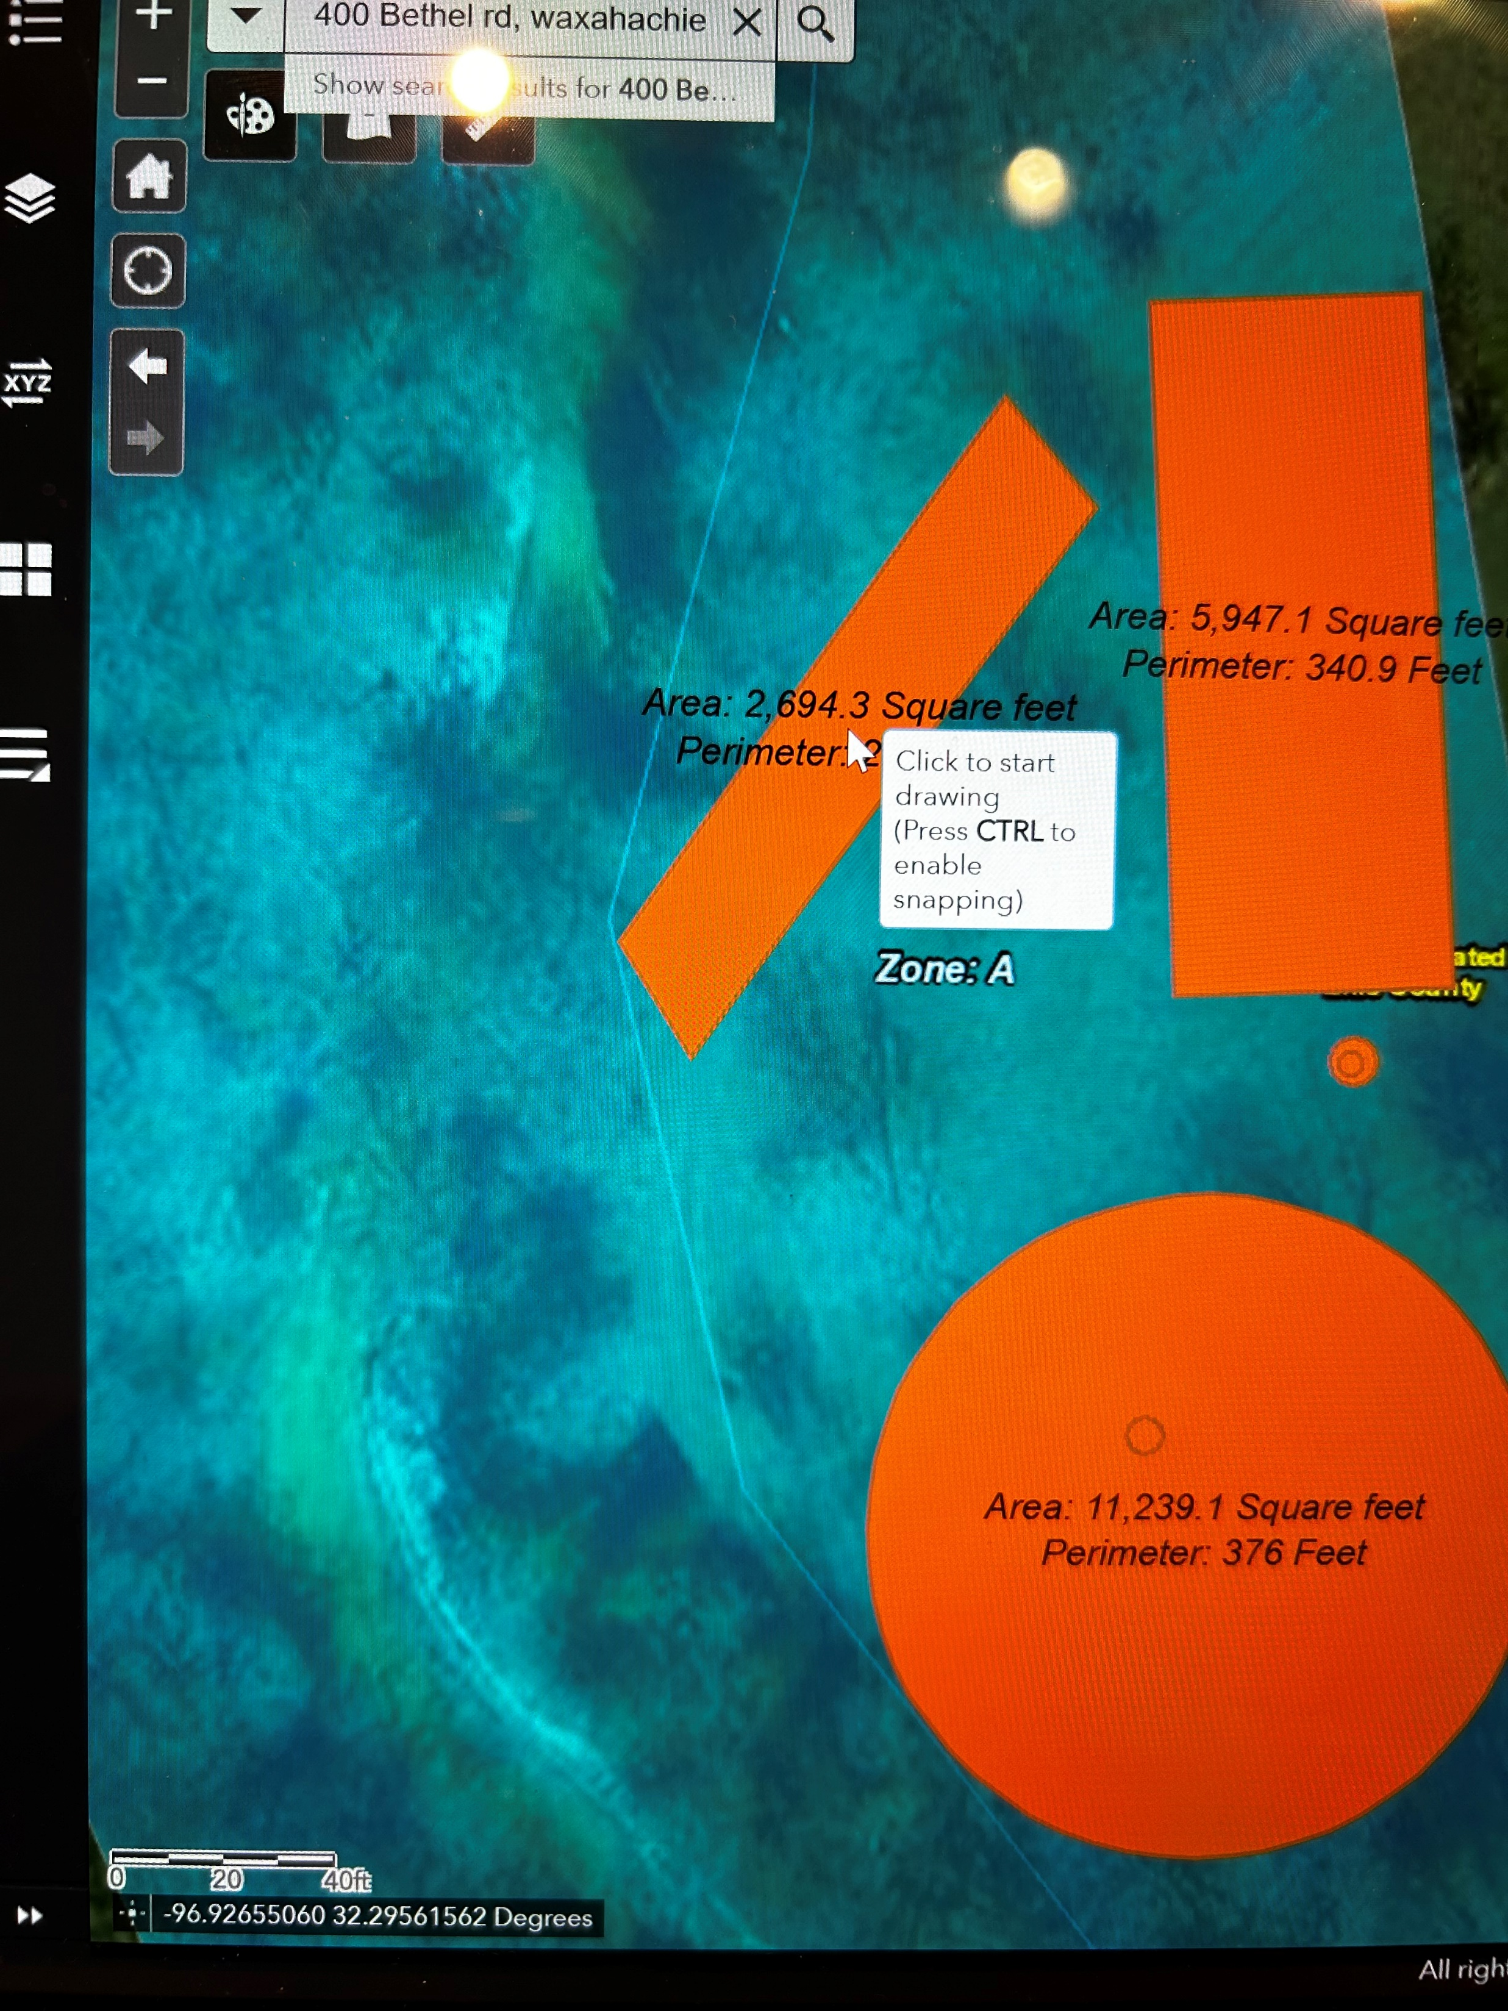

Center:
Cricket Practice Area
2,500 sq ft

